Slide 1
DWDM Project
Hotel Recommender System from Zomato Data

Slide 2
Goal statement
If a user inputs their preferences and their location, we should recommend a restaurant that they would enjoy.
This recommendation can use their location for nearby hotels, the rating of hotels, the cost of a meal, and many other features. We should try to minimise the number of computations done on the spot, so we should precalculate as much data as we can.

Slide 3
Methodology
From the zomato dataset, we extract all possible information.
To better simulate a hotel, we designed separate tables for food items and for restaurants. So, we have a Food Table that stores each food item, its primary key, and the classification for the food, as vegetarian, non-veg, egg only, and so on. We then link this Food Table to our Restaurant Table, which stores FKs to all Food items on its menu.

Slide 4
Methodology (contd.)
In the Restaurant Table, we also store the rating of the restaurant, the location of the restaurant in terms of address, the locality of the hotel, and its geographical coordinate. To produce all this information, we have used a Google Maps API to find latitude and longitude from a restaurant’s address.
We also stored the rating for each restaurant, and stored the approximate cost for a two person meal at that restaurant. With all this data, we cluster all the restaurants and store those clusters for use.
Lastly, when a user inputs their preferences, we predict the cluster that their preferences fall into, and present the user a choice of hotels in that same cluster. We made a frontend for the user to submit their preferences, and get recommended a hotel in the vicinity of their location.

Slide 5
Project Brief
We’ll talk about:
Data cleaning steps
Data augmentation steps
Visualisations done
Models trained
Prediction function

Slide 6
Data cleaning decisions
1.Dropped the ‘rest_type’ column.
listed_in(type) and restaurant type: restaurant type was submitted by restaurants, and often listed combinations of 26 base types. Rather than analysing each value and choosing which of the base types suited it best, we dropped the restaurant type and used listed_in(type) instead.
2.Dropped ‘listed_in(city)’ because it's coarser than the ‘location’ column.
Each row also stored listed_in(city) as well as location. Closer analysis showed location was much more specific than listed_in(city), so we dropped those columns.

Slide 7
Data Cleaning Decisions (contd.)
3.Renamed column ‘approx_cost(for two people)’ to ‘cost’.
This was done for ease of typing.
4.Removed ‘\5’ from the ‘rate’ column.
The ‘rate’ column was of the data type ‘object’. We removed the ‘\5’ from the column to keep just the rating and ease calculations on the column.
5.Set all new restaurants as zero-rating.
The newly added restaurants had the rating column as ‘NEW’. This was replaced by ‘0.0’.
6.Removed commas from the values of ‘cost’.

Slide 8
Data Cleaning Decisions (contd.)
7.Set ‘rate’ to the next 0.1 and ‘cost’ to the next 100.
Rounded off rate and cost values to nearest unit, to put everything as categorical values.
8.Extracted all valid entries from ‘menu_item’ column.
Most of the entries in the menu column was an empty list. These restaurants didn’t have their menu listed. We extracted only the valid ones.
9.Listed value counts of the columns: listed_in(type) and cuisines.
In order to get a better understanding of these columns and perform visualizations, we listed the value counts of these columns.

Slide 9
Data Cleaning Decisions (contd.)
10.Preprocessed the values in ‘menu_items’ and ‘dish_liked’ by:
Converting data to lower-case.
Getting rid of all punctuation.
Removing digits.
We cleaned the data that was present in these columns by first splitting the string and processing each of the values present.

Slide 10
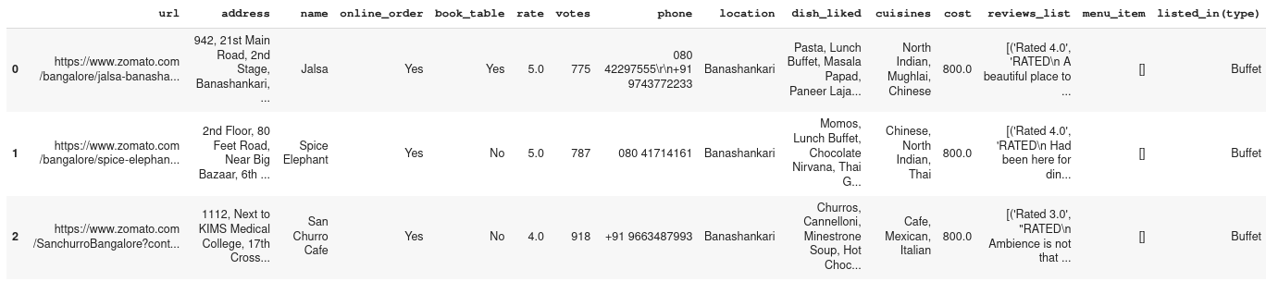
Data Cleaning Decisions (contd.)

Slide 11
Data Augmentation
1. Used the ‘address’ column to find latitude and longitude using Google Maps Geocode.
2.Created a ‘food_items’ column by merging ‘menu_item’ and ‘dish_liked’.
Some entries didn’t have their menu listed, but had their popular dishes listed. We combined the two columns to form the complete menu, and prioritise queries according to whether a dish is popular there, or just on the menu.

Slide 12
Data Augmentation (contd.)
3.Classified the food items into their appropriate segments using NLP.
The ‘food_items’ column was converted into a .csv file which was then processing using NLP techniques. We made meta-labels(topic_keywords) based on the overview of the data. Also, we defined the labels(topic_labels) before training the model. We then converted each keyword to a vector using GloVe. Following this, we converted our data into vectors as well. Finally, we computed a similarity matrix of each keyword to each topic, which gave us the output.
4. Used the percentages of food items of each category (veg, nonveg, dessert, etc), to classify whether the restaurant serves a category of food. We can use this as part of the preference data for recommendations.

Slide 13
Data Augmentation (contd.)
5. Used googlemaps API to generate a graph of locations. Now, when a user searches for restaurants, we can present results only from the vicinity of that location.

Slide 14
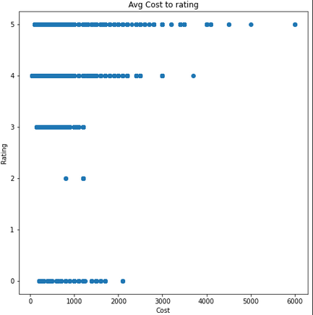
Data Visualization
Plotted the cost for two people against rating of hotel.

Slide 15
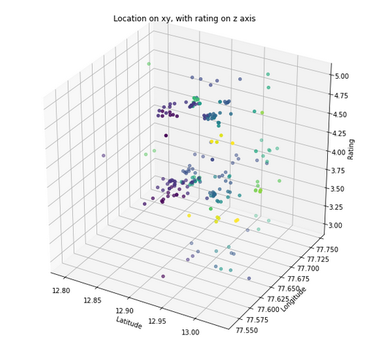
Data Visualization
Plotted latitude and longitude, with ratings on z axis, and different colours for each location.

Slide 16
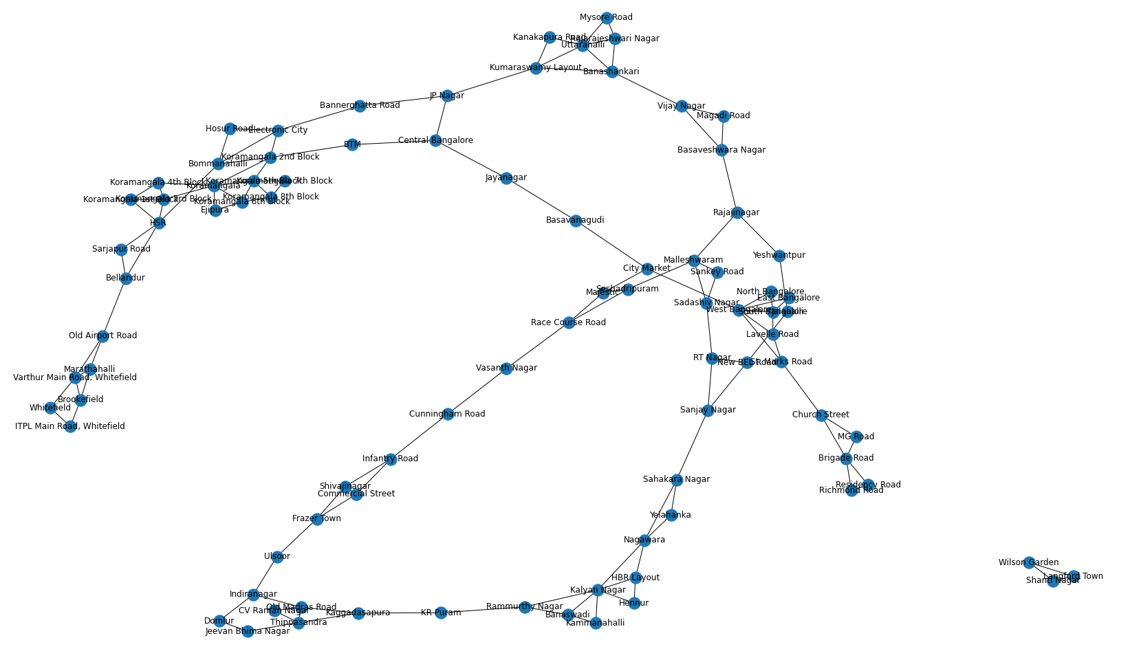
Data Visualization

Slide 17
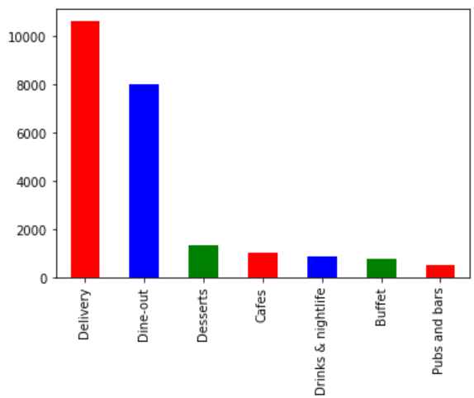
Data Visualization
Counts of each type of restaurant.

Slide 18
Models used
Colab has some strict RAM restrictions, so we aren’t able to test out all the models we wanted.
The goal of our project is to develop a good clustering that can be used to recommend other hotels similar to a user’s preferences. But since there’s no ground truth clustering labels, we have improvised a solution.
We train the entire dataset on the model, and use a subset of that data as our sample data. We then train another model, using only ...

Slide 19
Models used (contd.)
using only the leftover data (training data). We then predict the clusters of the sample data according to the second model, and compare those clusters with the clusters already formed in the first model.
When we repeat this experiment several times, and always obtain large RAND index scores, it implies that the clustering produced by the second model has high probability of occuring, implying that there exists an underlying structure to the data.
However, since this requires us to run the models several times, we have had difficulty picking models that are computationally weak enough to train multiple times, and strong enough to capture the nuance of data.
Till now, KMeans, Birch, DBScan, and Meanshift work. We use BIRCH clustering, because it provides very little dropoff even after number of clusters increases.

Slide 20
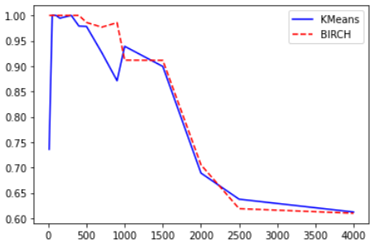
Models used (contd.)
RAND scores vs number of clusters

Slide 21
Preference based prediction function
How do we take a user’s input preferences, and cluster them to give a restaurant that they might like?
Each preference was a list of 13 numerical values: ['listed_in(type)', 'online_order', 'book_table', 'rate', 'cost', 'location', 'latitude', 'longitude', 'veg', 'non_veg', 'alcoholic_beverage', 'non_alcoholic_beverage', 'dessert'].
Latitude and Longitude could be obtained from the end user’s position, but we decided to just store latitudes and longitudes from each location, and hard code those instead.

Slide 22
Preference based prediction function (contd.)
Then, we built a flask frontend to collect this information, and to present the results.
Instead of training the model all over again, every time the server started, we just saved the weights of the model, and loaded them. We loaded the intermediate forms of the df and clustering data as well, since the augmentation process would involve a lot of delay from API Calls.
We also stored the adjacency graph, for the same reason.
Once we got the data from the frontend, we just had to display it, and that was that.

Slide 23
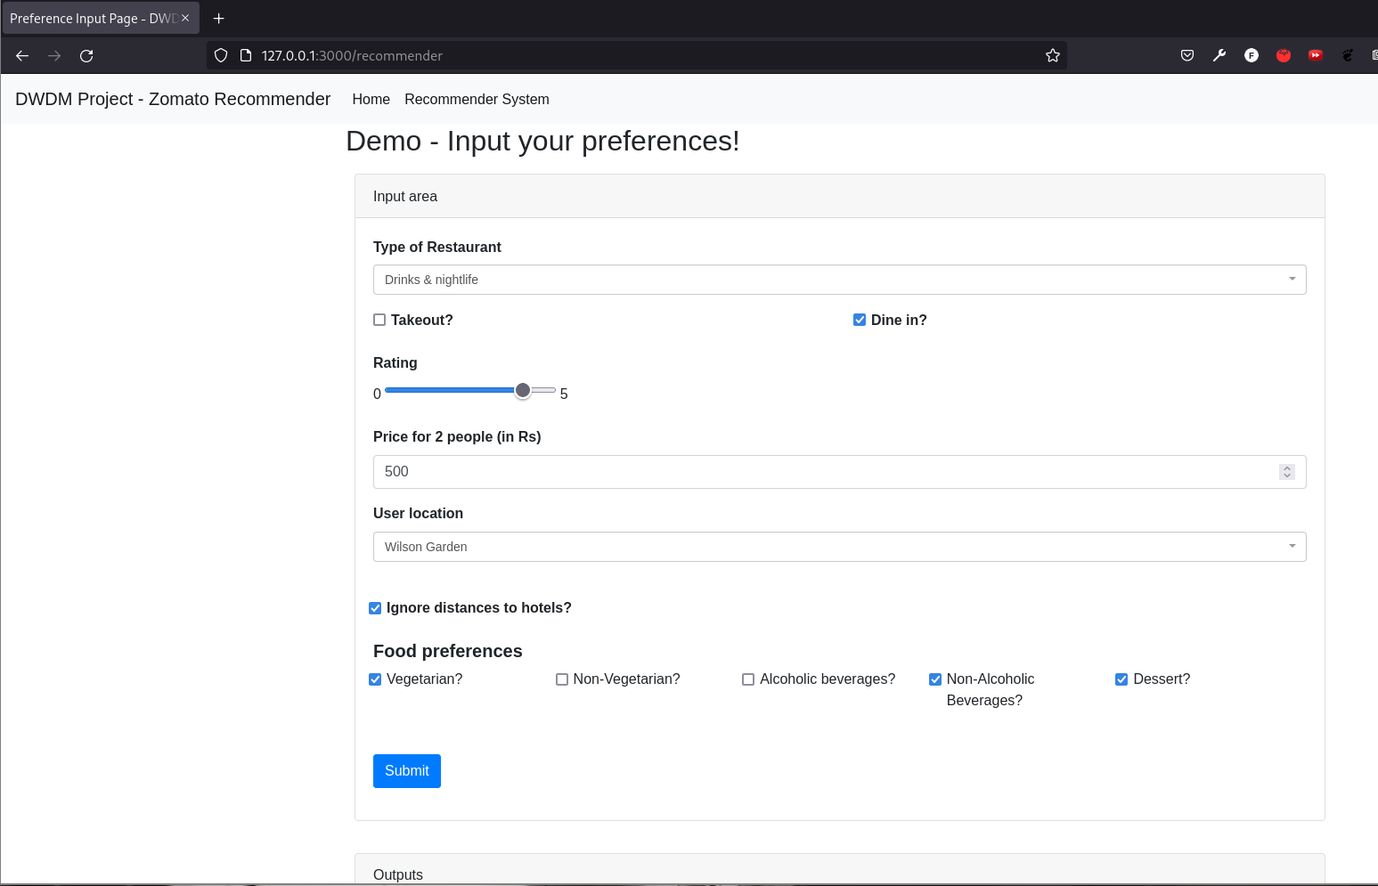
Preference based prediction function (contd.)

Slide 24
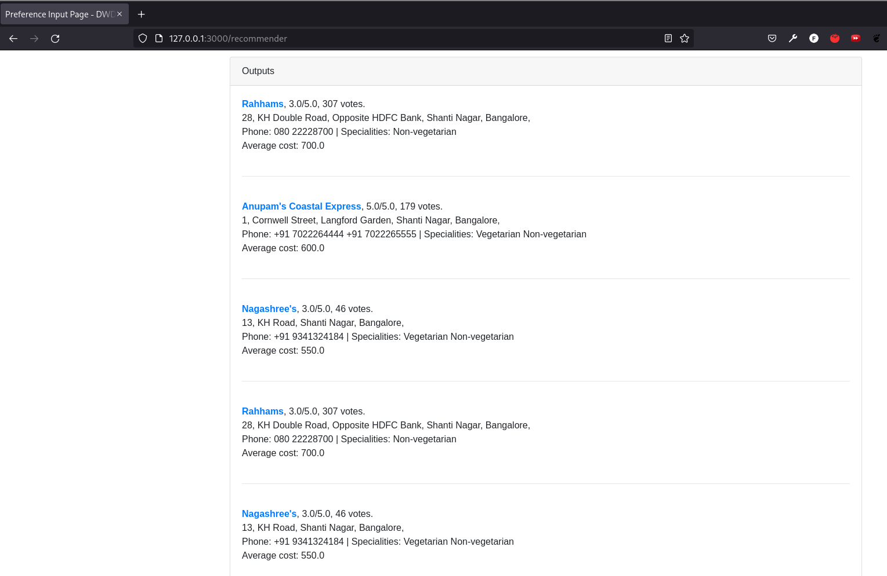
Preference based prediction function (contd.)

Slide 25
That’s it!
Thank you

